Slide 1
Modular of Aspects
Final Project,
SpaceWars AOP
Aviv Kotek, Raz Warman

Slide 2
We will:
Use Java code with AspectJ for implementing Aspects.
Use @AspectJ annotations style – more readable. Warman approve this
Implement our own annotations as pointCuts.
Add functionality to the game.
Logg, audit and control game behavior.
Analyze game behavior… and more!

Slide 3
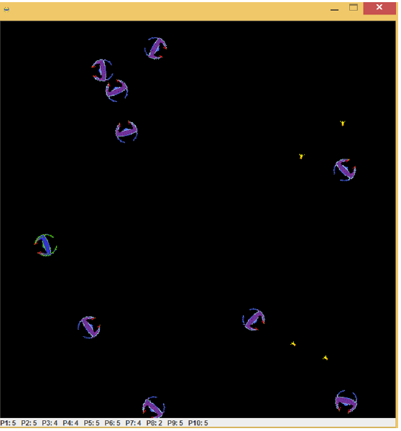
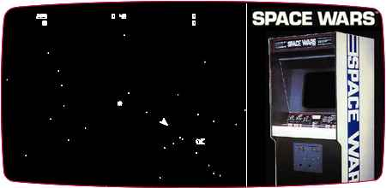
Base class: SpaceWars
Space Wars is a 1977 vector graphics arcade game based on the 1962PDP-1 program Spacewar!.
We will use the version written by us in OOP course.

Slide 4
Our main Aspects:
Spectative aspects:
Game Logging Aspect –
Audit Aspect -
Analysis aspect of the game: saves data of the whole game (not about players).
Regulative Aspects:
Lock aspect: locks some feature of the player - for e.g: can’t shoot anymore.
UI update aspect: each time some value is change (e.g: asteroid is hit) - we display it on screen.
Invasive Aspects:
Heuristic aspect: changes heuristic of the game (change from drunk player to smart player).
Asteroids creator aspect: creates objects each time we have annotation of @AsteroidEntity
EXCEPTION HANDLING ASPECT? Catches all not_catched exceptions?? Need to think on this as our program have no exceptions

Slide 5
In details

Slide 6
Game Logging Aspect (Game related):
Pointcut:
Use wildcard pattern of “get*” “do*”.
@Loggable custom made annotation in methods that do not conform with this pattern.
Advice: Log code into sw-log1 file.
Logs when:
Game has started + it details.
Ship has died.
Ship has teleported.
Collision occurred.

Slide 7
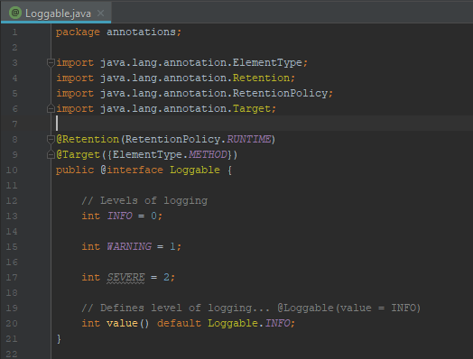
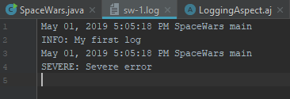
@Loggable
Logging levels:
Severe, Warning, Info, All
ALL < Info < Warning < Severe
Retention: Source/Runtime – not-visible/visible by the compiler.
Target: Method – use this annot only on methods.

Slide 8
Audit Aspect (Technical):
Logs (audits) data to a file using simple Java Logger (from Java.Util).
Logs when:
setOperations occurred.
getOperation occurred.
Do occured

Slide 9
Testing the aspects

Slide 10
Testing our aspects
Logging Aspect – just by checking the written files. If have time <write uni test to check file>

Slide 11
TODO:
Improve PPT
Finish aspects

